Slide 1

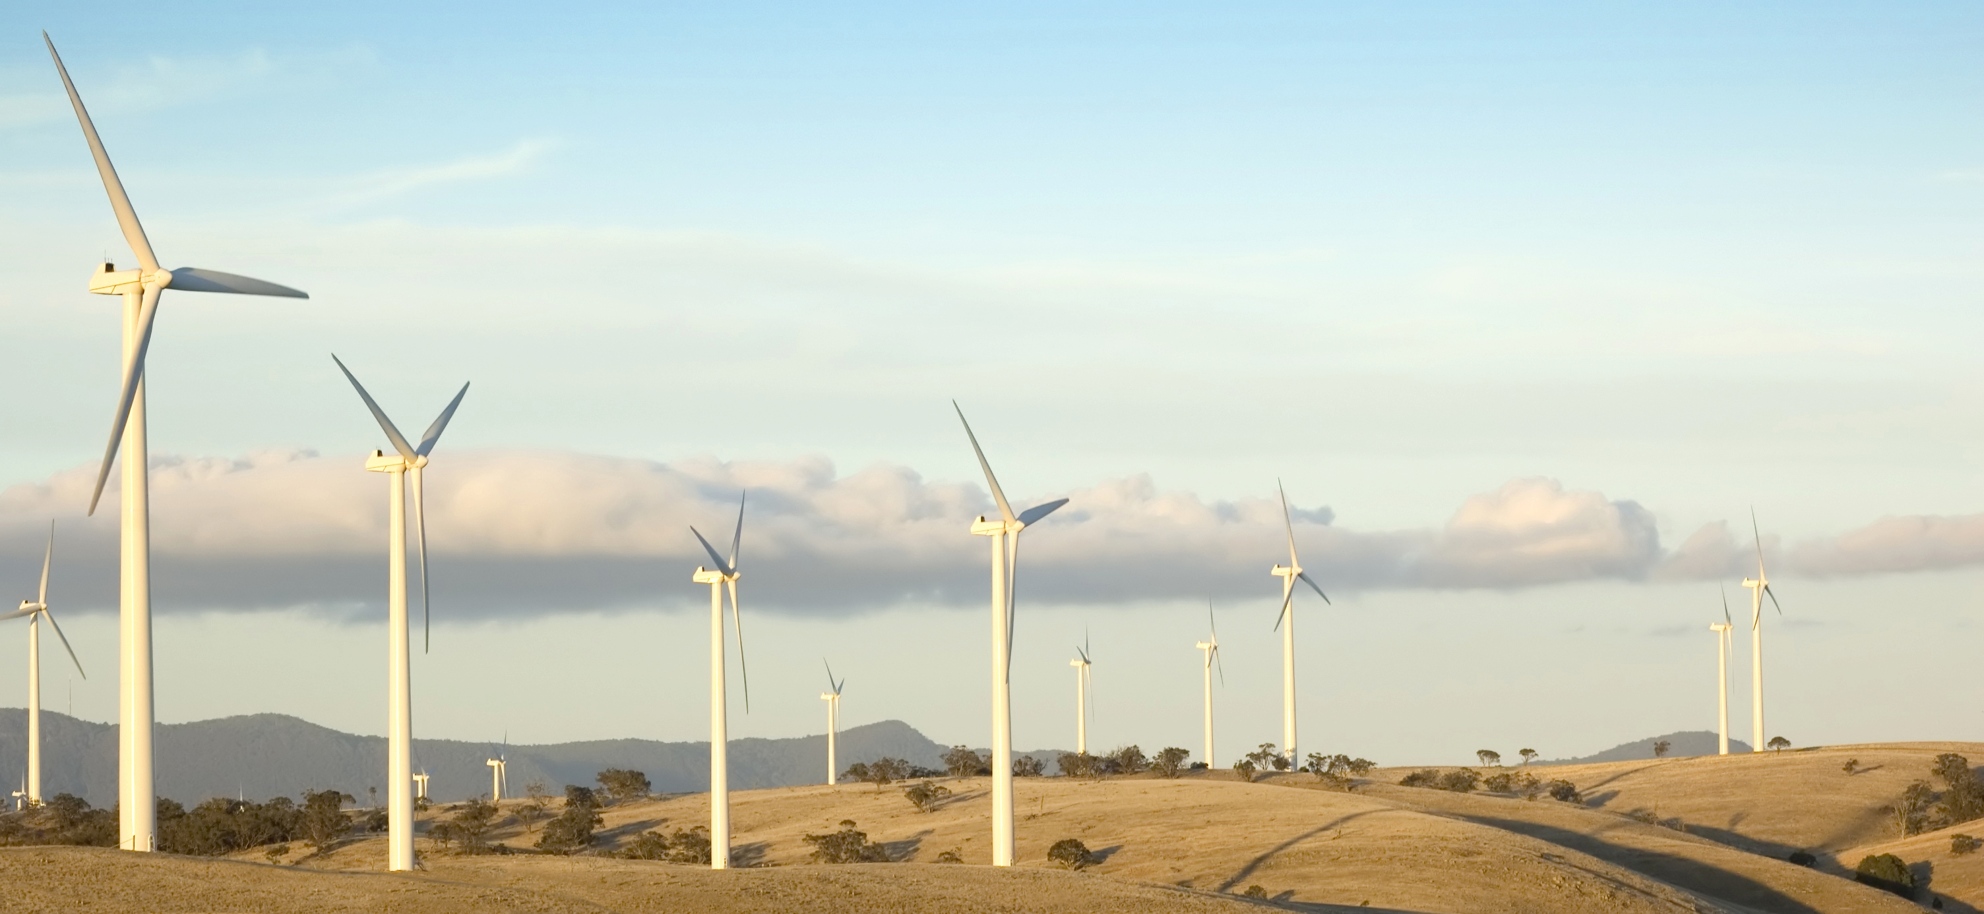
Mentoring to Increase Diversity in STEM
Bill Valdez
Acting Director
Office of Economic Impact and Diversity
Mentoring to Increase Diversity
Diversity Woman’s Business Conference
diversity.energy.gov
Notes:
Agenda- 10 min overview of DOE’s work and challenges, and the ways that states participate in them.

Slide 2
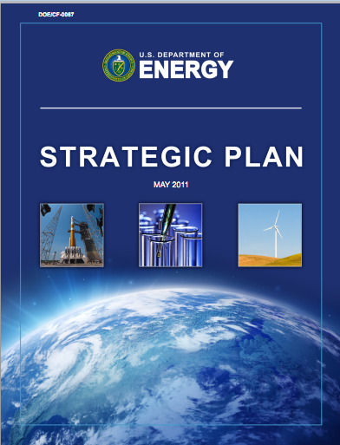
DOE’s Strategic Plan
The mission of the Department of Energy is to ensure America’s security and prosperity by addressing our energy, environmental, and national security challenges through transformative science and technology solutions.
For more: http://energy.gov/media/DOE_StrategicPlan.pdf

Slide 3

Education Challenges
Since the 1990s, the number of High School students taking trade or industry-related career and technical courses has declined by 35%.
According to 2011 Dept. of Education data, the most popular bachelor’s degrees are now business, social science and history, health, and education.
Only 18% of U.S. 12th graders performed at or above the proficient level in math and science.
The number of total test takers (both SAT and ACT) intending to pursue engineering careers declined from 7.7% in 1994, to 4.6% in 2006.
Notes:
Only 18% of U.S. 12th graders performed at or above the proficient level in math and science. (Nation’s Report Card, National Center for Education Statistics 2006.)
An analysis of SAT and ACT exit survey data reveals that the number of total test takers (both SAT and ACT) intending to pursue engineering careers declined from 7.7% in 1994, to 4.6% in 2006.
Since the 1990s, the number of HS students taking trade or industry-related career and technical courses has declined by 35%. (APPA. Work Force Planning for Public Power Utilities, 2005)

Slide 4
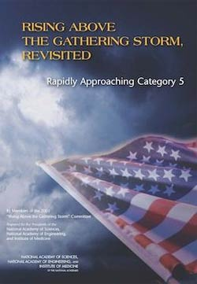
The U.S. anticipates a pipeline shortage of students
prepared to enter the clean energy sector
unless changes are made to attract, engage, educate
and train students.

Slide 5
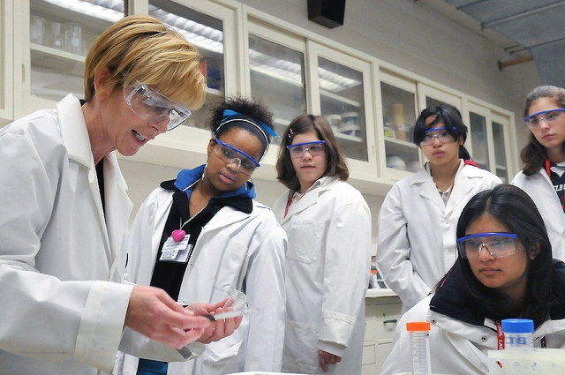
Mentoring – A Major Part of the Solution
Mentoring is particularly suited in STEM to help with diversity because STEM is a social networking activity:
“If I have seen further it is by standing on the shoulders of giants.” –Isaac Newton, 1676
The “Golden Circle” Phenomenon
Recommendations are a Key to Career Advancement
Ways to Get Mentoring:
At a College/University
At a Research Internship
Through Professional Societies
At its annual "Science Careers in Search of Women", Argonne National Laboratory demonstrates to 350 young women from Chicago-area high schools why a career in science might be right for them.

Slide 6
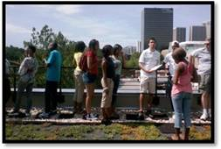
Clark Atlanta Sustainable Campus
Host to this year's High School Energy Summer Institute (HESI)
Train and promote energy science and engineering, multi-disciplinary educational and research among high school students
Instructors from Department of Energy (DOE), the Environmental Protection Agency (EPA), Clark Atlanta University, National Wildlife Federation, Metso Corporation, local government
During the program, the students were introduced and trained in the areas of alternative and renewable energy, recycling, conservation, weatherization, enabling technologies and training.

Slide 7
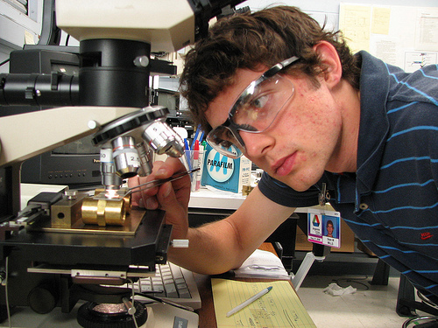
DOE Student Ambassadors
College students come to National Laboratories to work with researchers and scientists.
Our Student Ambassadors connect their campus to the DOE through presentations, networking, and events.
Sean Mills is obtaining photomicrographs of particle debris that are generated during friction and wear tests. He’s a 2009 intern at Argonne National Lab.
For more: http://energy.gov/scholarships&internships.htm
Notes:
MEISPP program in ED, 10 weeks here and at our labs
Community College Institute for science and technology – 10 weeks, mentor matches and new FY 11 partnership with TCUs
Office of Science Grad Fellowship SCGF supports outstanding students in the pursuit of graduate training in basic research in areas relevant to the Office of Science and encourages the development of the next generation scientific and technical talent in the U.S.

Slide 8
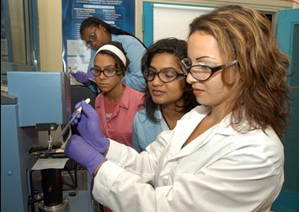
Faculty and Student Teams
The FaST teams work collaboratively with the scientists at DOE National Laboratories on cutting-edge science and technology projects and become part of the DOE system through training and mentorship.
For more information: http://science.energy.gov/wdts/fast/
Notes:
Image shown is Monument Valley, Utah, on Navajo Land
To promote science education and research among American Indian college students and faculty at TCUs and mainstream institutions with significant enrollment of American Indian students and/or active AISES chapters.
Integrate DOE and National Laboratory science resources into the national American Indian STEM educational infrastructure
Engage American Indian college students in relevant and exciting applied research engineering, and technology transfer projects conducted on Tribal Lands.

Slide 9
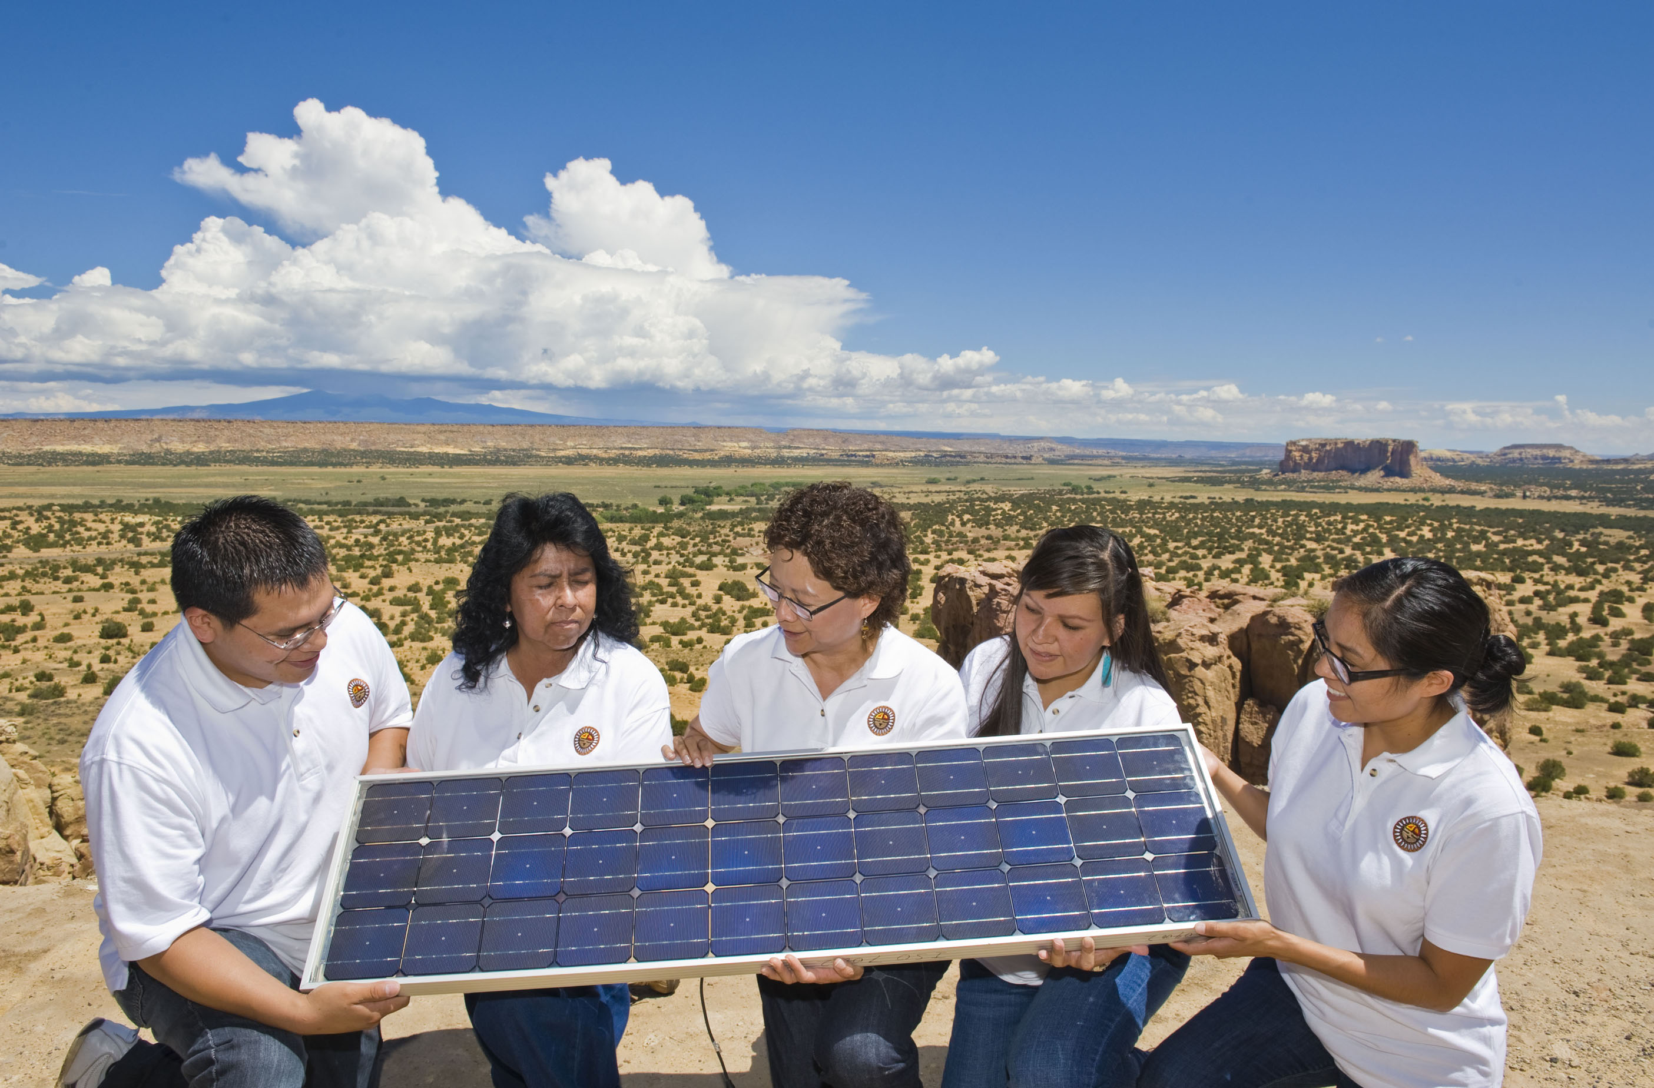
American Indian Research and Education Initiative
We partner with Native American organizations to support energy-related research projects on Tribal lands. AIREI project is conducted by American Indian students from mainstream universities and Tribal College Universities.
Sandra Begay-Campbell (center) with interns Devin Dick, Tammie Allen, Gepetta Billie and Chelsea Chee at Sky City within the Pueblo of Acoma. Begay-Campbell is describing how a photovoltaic panel works to generate electricity. (Photo by Randy Montoya)
For more information: http://diversity.energy.gov
Notes:
Image shown is Monument Valley, Utah, on Navajo Land
To promote science education and research among American Indian college students and faculty at TCUs and mainstream institutions with significant enrollment of American Indian students and/or active AISES chapters.
Integrate DOE and National Laboratory science resources into the national American Indian STEM educational infrastructure
Engage American Indian college students in relevant and exciting applied research engineering, and technology transfer projects conducted on Tribal Lands.

Slide 10
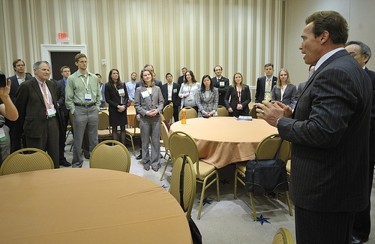
Office of Science Graduate Fellowship Program
$22.7 million program to support outstanding students pursing graduate training in the sciences.
Graduate students receive a three-year graduate fellowship, which includes tuition, living expenses, and research support.
Introduces young scientists to our National Laboratories to accelerate their work on energy-related topics.
At the ARPA-E Energy Innovation Summit Steven Chu, Secretary, United States Department of Energy and Arnold Schwarzenegger, Former Governor of California surprise graduate students who traveled to the summit.
Notes:
Only 18% of U.S. 12th graders performed at or above the proficient level in math and science. (Nation’s Report Card, National Center for Education Statistics 2006.)
An analysis of SAT and ACT exit survey data reveals that the number of total test takers (both SAT and ACT) intending to pursue engineering careers declined from 7.7% in 1994, to 4.6% in 2006.
Since the 1990s, the number of HS students taking trade or industry-related career and technical courses has declined by 35%. (APPA. Work Force Planning for Public Power Utilities, 2005)

Slide 11
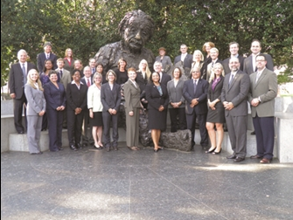
Albert Einstein Distinguished Educator Fellow Program
Distinguished educator fellowships for elementary and secondary school mathematics and science teachers.
Selected teachers spend eleven months in a Congressional Office or a Federal agency.
Intended to support the intellectual and professional development of teachers who want to contribute their expertise of and be involved in the advancement of science, mathematics, and technology education.
Notes:
Only 18% of U.S. 12th graders performed at or above the proficient level in math and science. (Nation’s Report Card, National Center for Education Statistics 2006.)
An analysis of SAT and ACT exit survey data reveals that the number of total test takers (both SAT and ACT) intending to pursue engineering careers declined from 7.7% in 1994, to 4.6% in 2006.
Since the 1990s, the number of HS students taking trade or industry-related career and technical courses has declined by 35%. (APPA. Work Force Planning for Public Power Utilities, 2005)

Slide 12
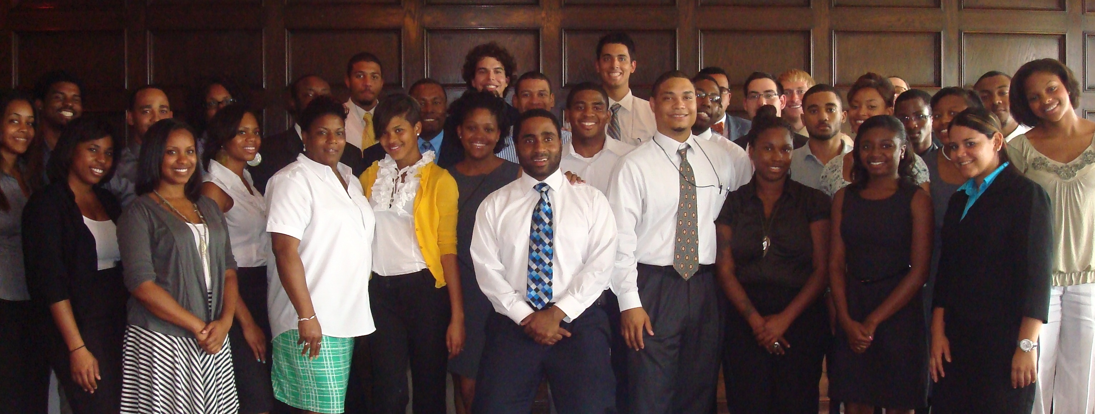
Minority Education Institution Student Partnership Program
Gain 10 weeks of substantive professional and technical career experience while working side-by-side with an assigned mentor who is a subject matter expert. Mentors help students tailor their practical work experience to their professional interests.
For more information: http://www.doeminorityinternships.org
Notes:
Image shown is Monument Valley, Utah, on Navajo Land
To promote science education and research among American Indian college students and faculty at TCUs and mainstream institutions with significant enrollment of American Indian students and/or active AISES chapters.
Integrate DOE and National Laboratory science resources into the national American Indian STEM educational infrastructure
Engage American Indian college students in relevant and exciting applied research engineering, and technology transfer projects conducted on Tribal Lands.

Slide 13
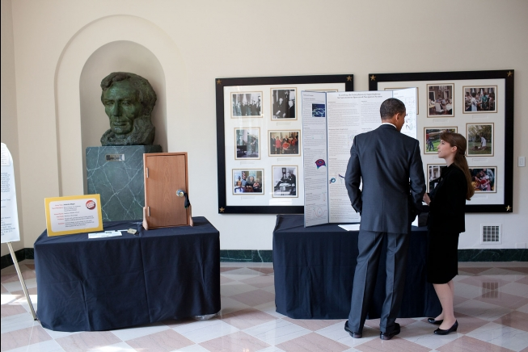
Council on Women and Girls Mentorship Program
DC area female undergraduate students matched to women employees in STEM fields at DOE
26 pairs, meet regularly, conducting job fairs and other events
Hope that mentees become mentors to younger generation
President Obama stops at exhibits in the White House following the White House Science Fair, October 18, 2010.
Notes:
Only 18% of U.S. 12th graders performed at or above the proficient level in math and science. (Nation’s Report Card, National Center for Education Statistics 2006.)
An analysis of SAT and ACT exit survey data reveals that the number of total test takers (both SAT and ACT) intending to pursue engineering careers declined from 7.7% in 1994, to 4.6% in 2006.
Since the 1990s, the number of HS students taking trade or industry-related career and technical courses has declined by 35%. (APPA. Work Force Planning for Public Power Utilities, 2005)

Slide 14
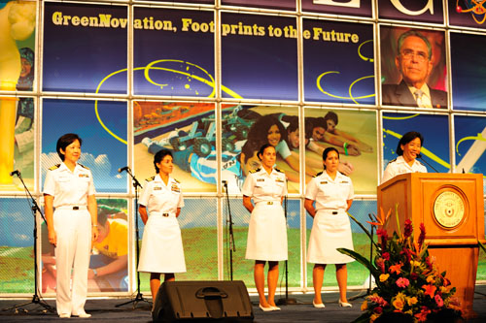
Mentoring Through Professional Societies
Membership in professional societies gives access to networking, development, and mentoring opportunities.
DOE works with groups and conferences like:
Hispanic Association of Colleges and Universities
Asian American Government Executives Network
Great Minds in STEM
American Indian Higher Education Consortium
The Hispanic Engineering, Science, and Technology Week runs Latina Day, an event dedicated to celebrating and promoting women in the science, technology, engineering and math (STEM) fields. Hundreds of mother/daughter teams from throughout South Texas are brought together to hear the inspiring stories of prominent women of all colors succeeding in careers and job tracks once exclusive to men.
Notes:
Only 18% of U.S. 12th graders performed at or above the proficient level in math and science. (Nation’s Report Card, National Center for Education Statistics 2006.)
An analysis of SAT and ACT exit survey data reveals that the number of total test takers (both SAT and ACT) intending to pursue engineering careers declined from 7.7% in 1994, to 4.6% in 2006.
Since the 1990s, the number of HS students taking trade or industry-related career and technical courses has declined by 35%. (APPA. Work Force Planning for Public Power Utilities, 2005)

Slide 15
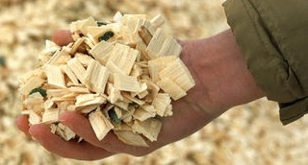
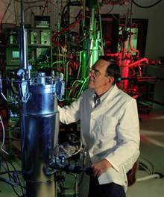


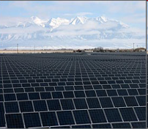
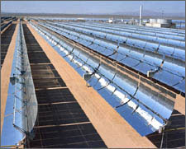

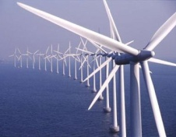
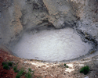
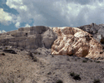
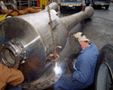

Thank You
Bill Valdez
Bill.valdez@hq.doe.gov
Office of Economic Impact and Diversity
Notes:
15

